Slide 1
N. Rizk
COSC 3337 : Data Science I
College of Natural and Applied Sciences
Department of Computer Science
University of Houston

Slide 2
K-means Clustering
Partitioning Clustering Approach
a typical clustering analysis approach via iteratively partitioning training data set to learn a partition of the given data space
learning a partition on a data set to produce several non-empty clusters (usually, the number of clusters given in advance)
in principle, optimal partition achieved via minimising the sum of squared distance to its “representative object” in each cluster
e.g., Euclidean distance

Slide 3
Introduction
Given a K, find a partition of K clusters to optimise the chosen partitioning criterion (cost function)
global optimum: exhaustively search all partitions
The K-means algorithm: a heuristic method
K-means algorithm (MacQueen’67): each cluster is represented by the centre of the cluster and the algorithm converges to stable centriods of clusters.
K-means algorithm is the simplest partitioning method for clustering analysis and widely used in data mining applications.

Slide 4
K-means Algorithm
Given the cluster number K, the K-means algorithm is carried out in three steps after initialisation:
Initialisation: set seed points (randomly)
Assign each object to the cluster of the nearest seed point measured with a specific distance metric
Compute new seed points as the centroids of the clusters of the current partition (the centroid is the centre, i.e., mean point, of the cluster)
Go back to Step 1), stop when no more new assignment (i.e., membership in each cluster no longer changes)

Slide 5
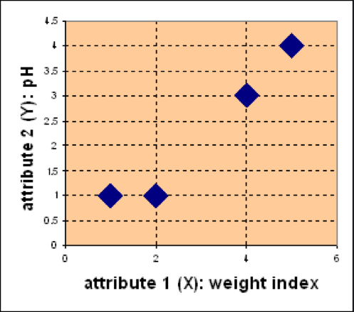
Example
Problem
Suppose we have 4 types of medicines and each has two attributes (pH and
weight index). Our goal is to group these objects into K=2 group of medicine.
D
Medicine | Weight | pH-Index
A | 1 | 1
B | 2 | 1
C | 4 | 3
D | 5 | 4
C
A
B

Slide 6
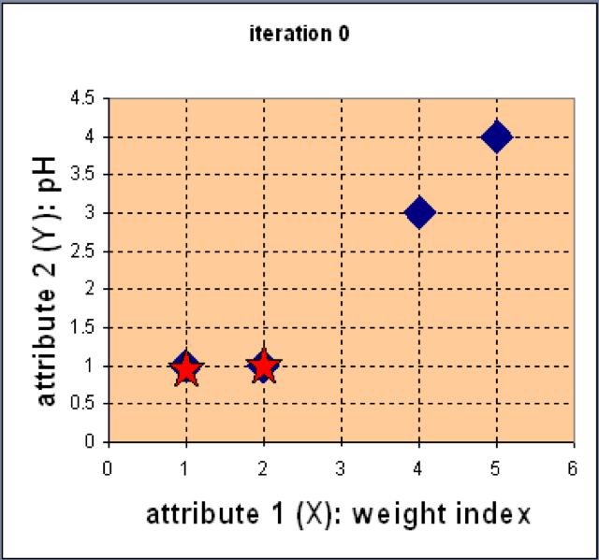
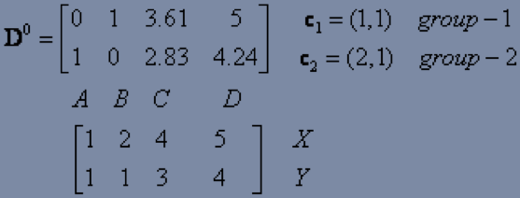
Example
Step 1: Use initial seed points for partitioning
D
C
Euclidean distance
A
B
Assign each object to the cluster
with the nearest seed point

Slide 7
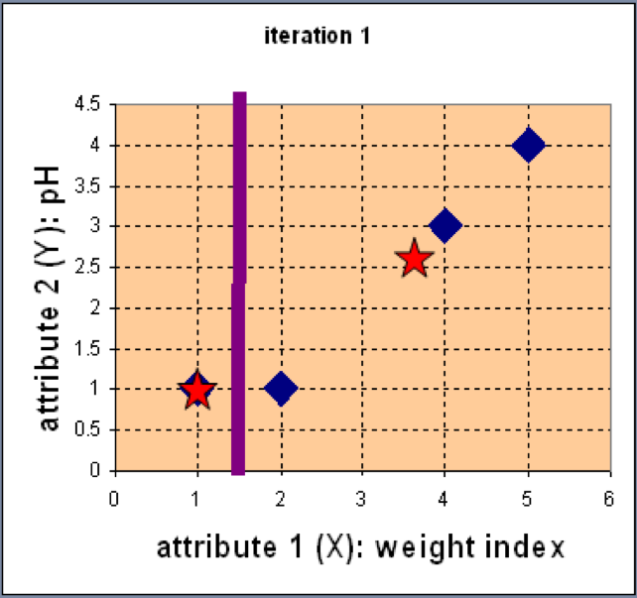
Example
Step 2: Compute new centroids of the current partition
Knowing the members of each
cluster, now we compute the new
centroid of each group based on
these new memberships.

Slide 8
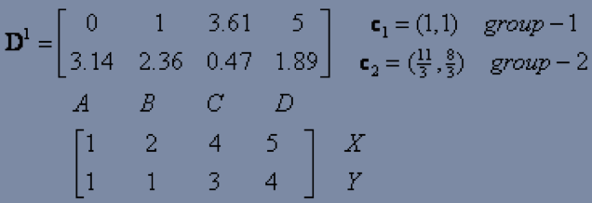
Example
Step 2: Renew membership based on new centroids
Compute the distance of all objects to the new centroids
Assign the membership to objects

Slide 9
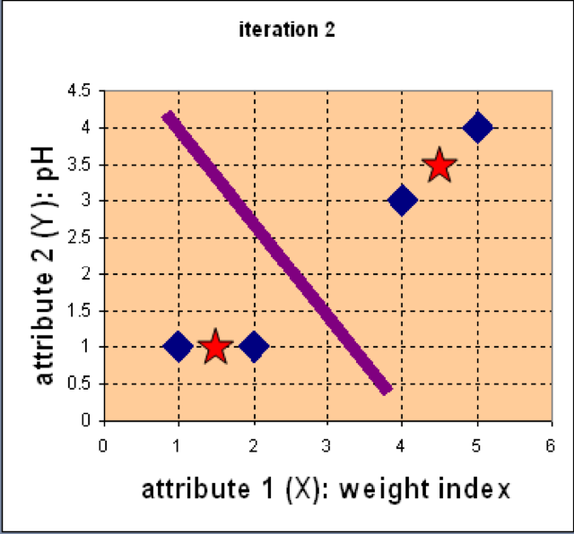
Example
Step 3: Repeat the first two steps until its convergence
Knowing the members of each
cluster, now we compute the new
centroid of each group based on
these new memberships.

Slide 10
Example
Step 3: Repeat the first two steps until its convergence
Compute the distance of all objects to the new centroids
Stop due to no new assignment
Membership in each cluster no longer change

Slide 11
Exercise
For the medicine data set, use K-means with the Manhattan distance
metric for clustering analysis by setting K=2 and initialising seeds as
C1 = A and C2 = C. Answer three questions as follows:
How many steps are required for convergence?
What are memberships of two clusters after convergence?
What are centroids of two clusters after convergence?
Medicine | Weight | pH-Index
A | 1 | 1
B | 2 | 1
C | 4 | 3
D | 5 | 4
D
C
A
B

Slide 12
Detailed Example
Sample Data set
Step 1 take 2 randomly
Objects | X | Y | Z
OB-1 | 1 | 4 | 1
OB-2 | 1 | 2 | 2
OB-3 | 1 | 4 | 2
OB-4 | 2 | 1 | 2
OB-5 | 1 | 1 | 1
OB-6 | 2 | 4 | 2
OB-7 | 1 | 1 | 2
OB-8 | 2 | 1 | 1
Task is to cluster these objects into two clusters

Slide 13
Algorithm steps
Taking any two centroids or data points (as you took 2 as K hence the number of centroids also 2) in its account initially.
After choosing the centroids, (say C1 and C2) the data points (coordinates here) are assigned to any of the Clusters (let’s take centroids = clusters for the time being) depending upon the distance between them and the centroids.
Assume that the algorithm chose OB-2 (1,2,2) and OB-6 (2,4,2) as centroids and cluster 1 and cluster 2 as well.
measuring the distances d=|x2–x1|+|y2–y1|+|z2–z1| (Manhathan Distance)

Slide 14
Step 1:calculation of distances between the objects and centroids (OB-2 and OB-6):
Objects | X | Y | Z | Distance from C1(1,2,2) | Distance from C2(2,4,2)
OB-1 | 1 | 4 | 1 | 3 | 2
OB-2 | 1 | 2 | 2 | 0 | 3
OB-3 | 1 | 4 | 2 | 2 | 1
OB-4 | 2 | 1 | 2 | 2 | 3
OB-5 | 1 | 1 | 1 | 2 | 5
OB-6 | 2 | 4 | 2 | 3 | 0
OB-7 | 1 | 1 | 2 | 1 | 4
OB-8 | 2 | 1 | 1 | 3 | 4

Slide 15
An object which has a shorter distance between a centroid (say C1) than the other centroid (say C2) will fall into the cluster of C1.
Step 2: Cluster Formation
Objects | X | Y | Z | Distance from C1(1,2,2) | Distance from C2(2,4,2)
OB-1 | 1 | 4 | 1 | 3 | 2
OB-2 | 1 | 2 | 2 | 0 | 3
OB-3 | 1 | 4 | 2 | 2 | 1
OB-4 | 2 | 1 | 2 | 2 | 3
OB-5 | 1 | 1 | 1 | 2 | 5
OB-6 | 2 | 4 | 2 | 3 | 0
OB-7 | 1 | 1 | 2 | 1 | 4
OB-8 | 2 | 1 | 1 | 3 | 4
Cluster 1
OB-2
OB-4
OB-5
OB-7
OB-8
Cluster 2
OB-1
OB-3
OB-6

Slide 16

updating cluster centroids
New C1
Objects | X | Y | Z | Distance from C1(1.4,1.2,1.6) | Distance from C2(1.33, 4, 1.66)
OB-1 | 1 | 4 | 1 | 3.8 | 1
OB-2 | 1 | 2 | 2 | 1.6 | 2.66
OB-3 | 1 | 4 | 2 | 3.6 | 0.66
OB-4 | 2 | 1 | 2 | 1.2 | 4
OB-5 | 1 | 1 | 1 | 1.2 | 4
OB-6 | 2 | 4 | 2 | 3.8 | 1
OB-7 | 1 | 1 | 2 | 1 | 3.66
OB-8 | 2 | 1 | 1 | 1.4 | 4.33
the updated cluster 1 will be ((1+2+1+1+2)/5, (2+1+1+1+1)/5,(2+2+1+2+1)/5) = (1.4,1.2,1.6).
New C2
And for cluster 2 it will be ((1+1+2)/3, (4+4+4)/3, (1+2+2)/3) = (1.33, 4, 1.66).

Slide 17
Objects | X | Y | Z | Distance from C1(1.4,1.2,1.6) | Distance from C2(1.33, 4, 1.66)
OB-1 | 1 | 4 | 1 | 3.8 | 1
OB-2 | 1 | 2 | 2 | 1.6 | 2.66
OB-3 | 1 | 4 | 2 | 3.6 | 0.66
OB-4 | 2 | 1 | 2 | 1.2 | 4
OB-5 | 1 | 1 | 1 | 1.2 | 4
OB-6 | 2 | 4 | 2 | 3.8 | 1
OB-7 | 1 | 1 | 2 | 1 | 3.66
OB-8 | 2 | 1 | 1 | 1.4 | 4.33
Cluster 1
OB-2
OB-4
OB-5
OB-7
OB-8
It is convergence
Cluster 2
OB-1
OB-3
OB-6
This is where the algorithm no longer updates the centroids. Because there is no change in the current cluster formation, it is the same as the previous formation.

Slide 18
Step 3: Apply test sets
Test Sets
Cluster 1
OB-2
OB-3
OB-4
Distance from C1(1.4,1.2,1.6) | Distance from C2(1.33, 4, 1.66)
4 | 0.73
2.4 | 3.01
1.6 | 2.99
1.4 | 3.33
Objects | X | Y | Z
OB-1 | 2 | 4 | 1
OB-2 | 2 | 2 | 2
OB-3 | 1 | 2 | 1
OB-4 | 2 | 2 | 1
Cluster 2
OB-1
d=|x2–x1|+|y2–y1|+|z2–z1| (Manhathan Distance)

Slide 19
Step 4: Measuring performance
Adjusted rand index
Mutual information based scoring
Homogeneity, completeness and v-measure

Slide 20
Kmeans Disadvatnages
Requires to pre-specify the number of clusters (k)➔Hierarchical clustering is an alternative approach that does not require a particular choice of clusters.
is sensitive to outliers (it affects the outcomes) and different results can occur if you change the ordering of the data. CAREFULLY!!!
K-Means is a lazy learner where generalization of the training data is delayed until a query is made to the system.
Learning methods can construct a different approximation or result( based on data) to the target function for each encountered query.
It is a good method for online learning, but it requires a possibly large amount of memory to store the data, and each request involves starting the identification of a local model from scratch.

Slide 21
Variants of K-mean
There are several variants of K-means to overcome its weaknesses
K-Medoids: resistance to noise and/or outliers
K-Modes: extension to categorical data clustering analysis
CLARA: extension to deal with large data sets
Mixture models (EM algorithm): handling uncertainty of clusters
CLUSTERING IS UNSUPERVISED

Slide 22
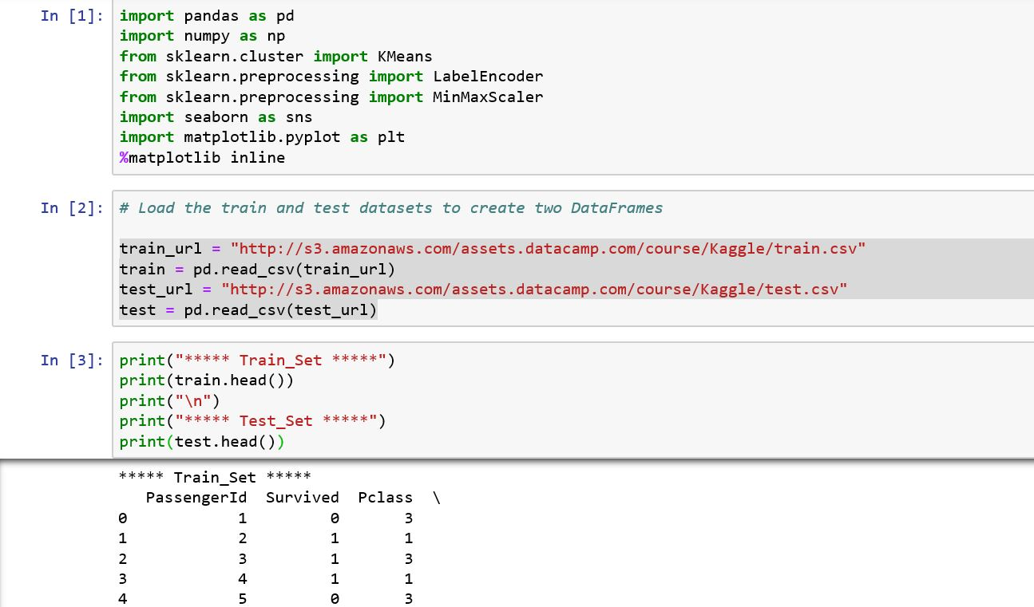
K-Means Clustering in Python with scikit-learn

Slide 23
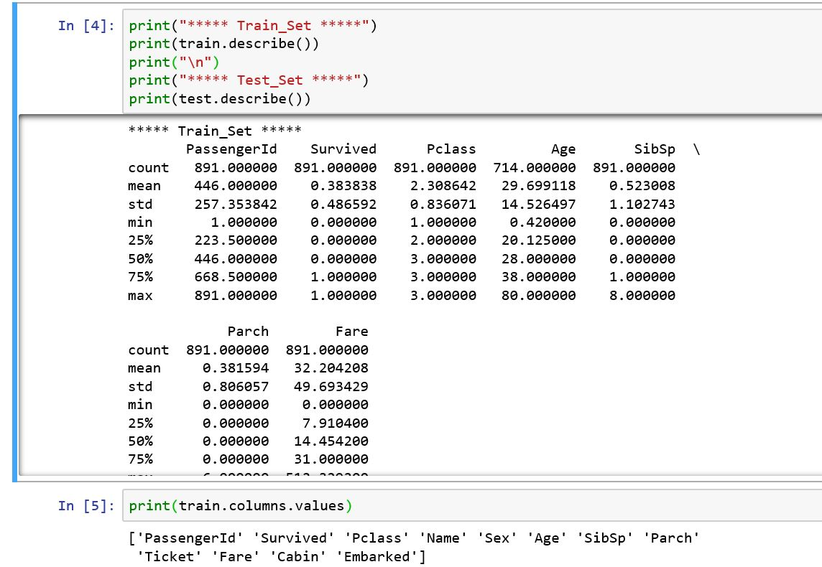
What is the describe -> Statiscis

Slide 24
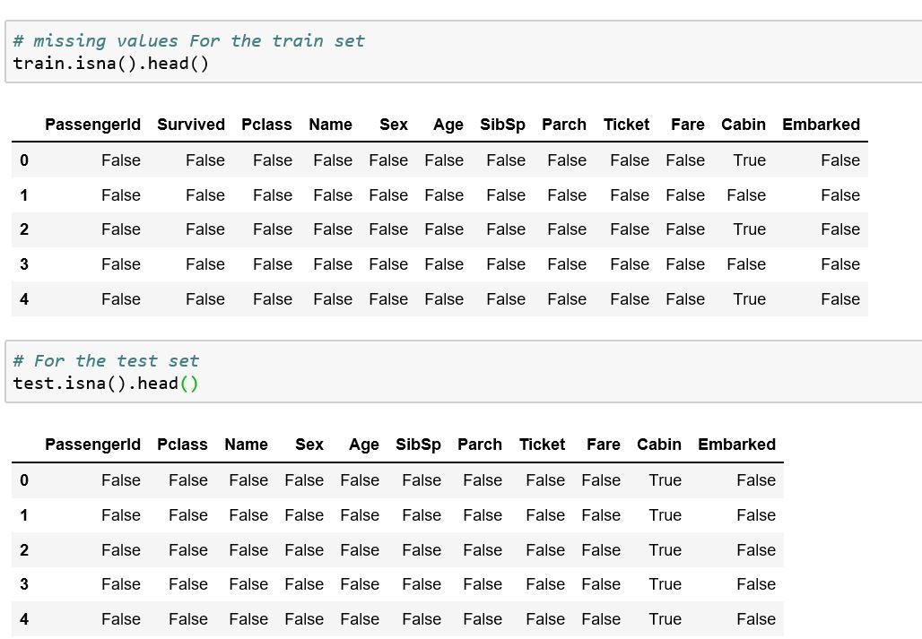

Slide 25
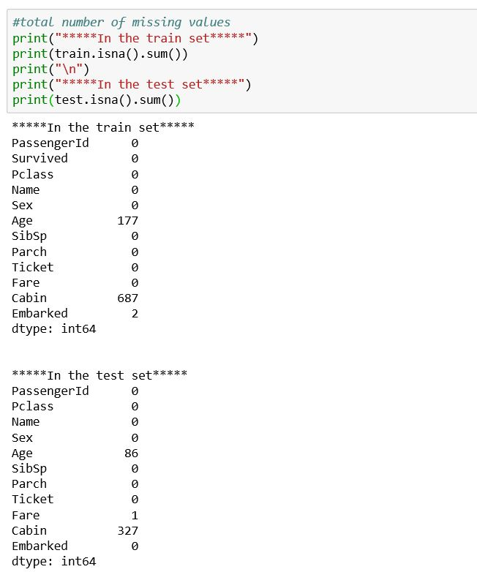
Replacing

Slide 26
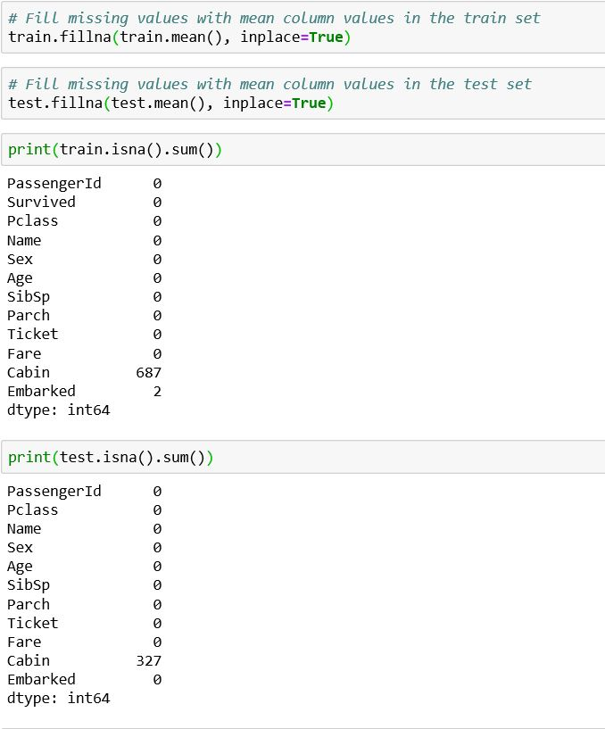

Slide 27
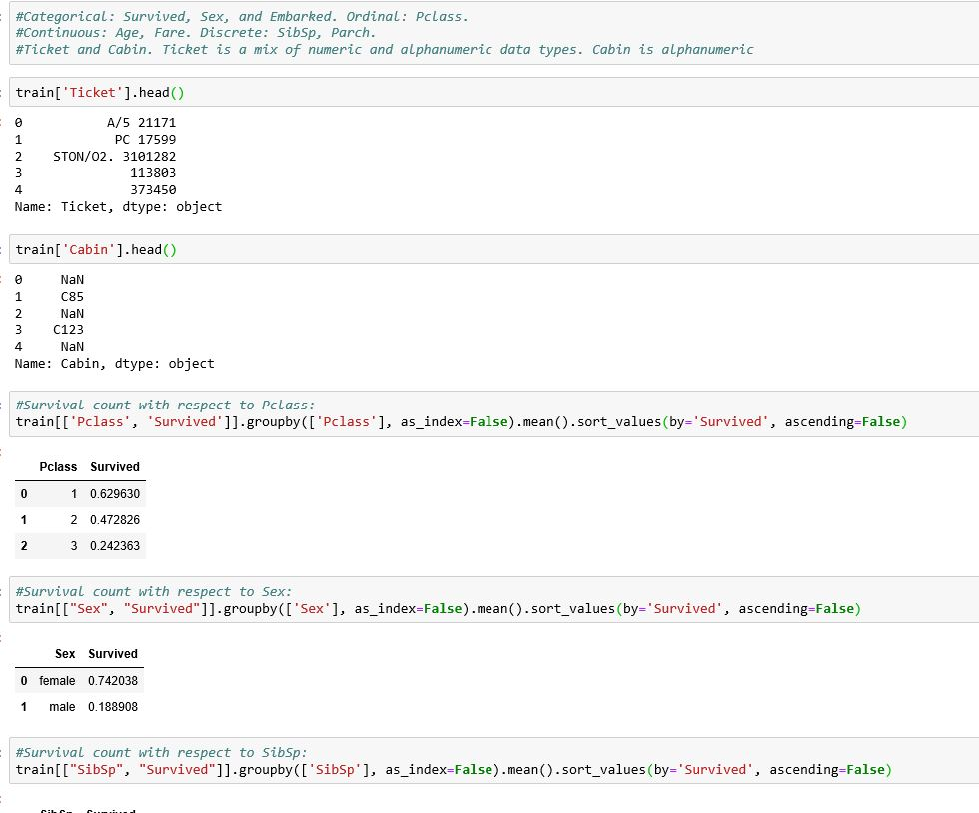

Slide 28
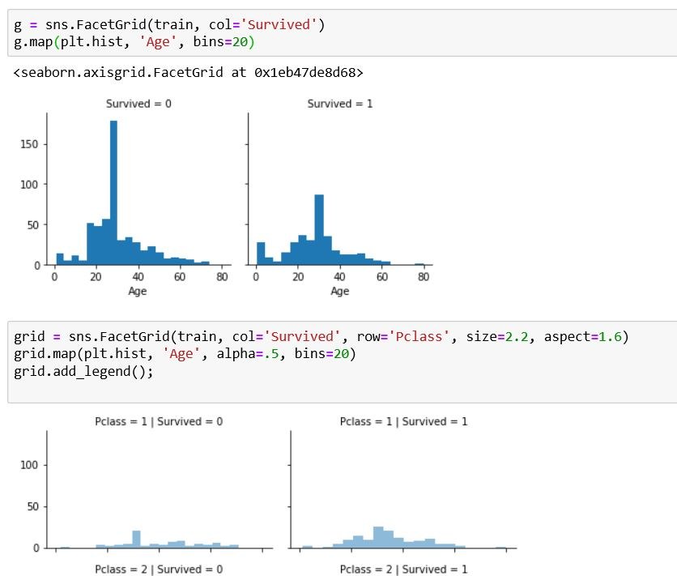
WHAT IS THE ADVANTAGE of binning-> good for labeling

Slide 29
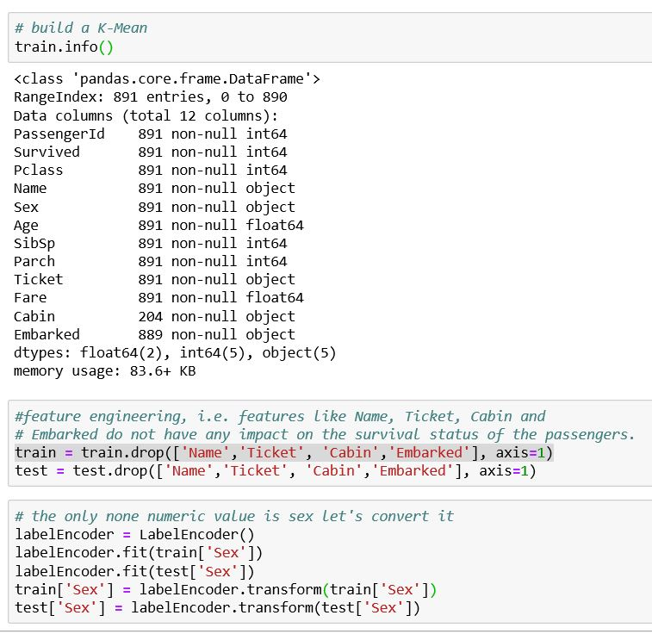
Max_iter

Slide 30
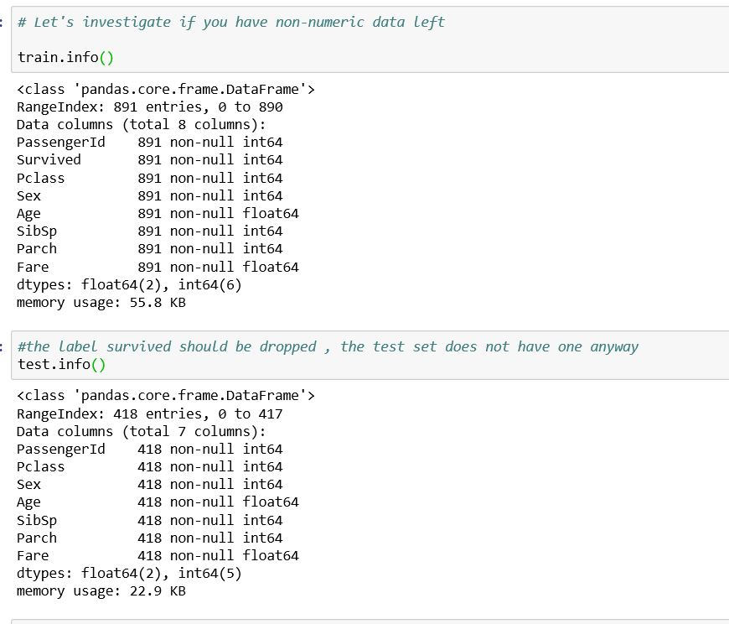

Slide 31
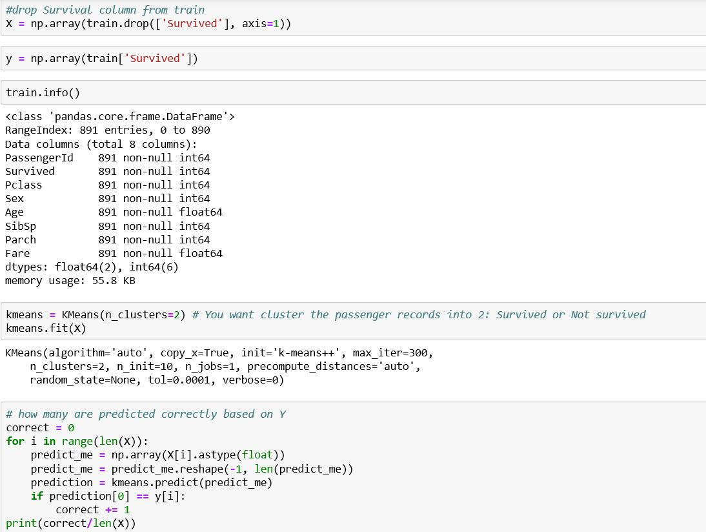

Slide 32
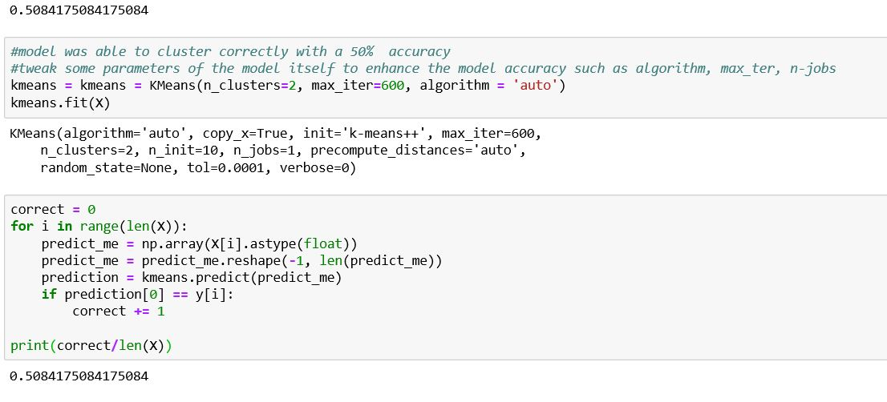
Accuracy of K-Means

Slide 33
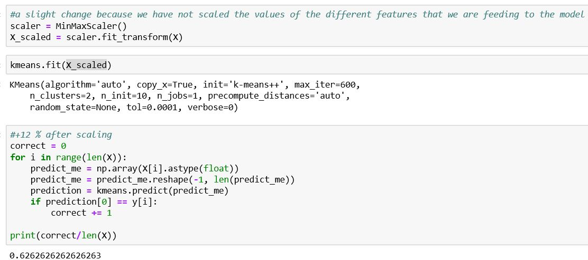
Do not use K-mean without scaling
It will give us accurate results and improve speed

Slide 34
Determine optimal k

Slide 35
Centroid, Radius and Diameter of a Cluster (for numerical data sets)
Centroid: the “middle” of a cluster
Radius: square root of average distance from any point of the cluster to its centroid
Diameter: square root of average mean squared distance between all pairs of points in the cluster
35
Notes:
35

Slide 36
The elbow method is used to determine the optimal number of clusters in k-means clustering.What is the elbow? Try to find the optimal number
The elbow method plots the value of the cost function produced by different values of k.
If k increases, average distortion will decrease, each cluster will have fewer constituent instances, and the instances will be closer to their respective centroids.
However, the improvements in average distortion will decline as k increases. The value of k at which improvement in distortion declines the most is called the elbow, at which we should stop dividing the data into further clusters.

Slide 37
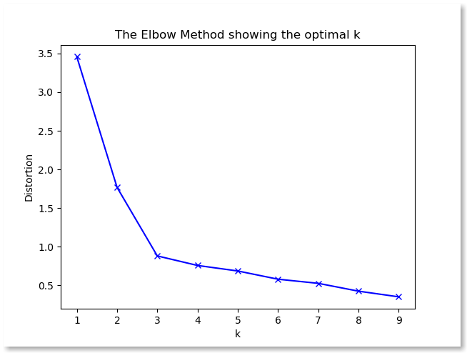
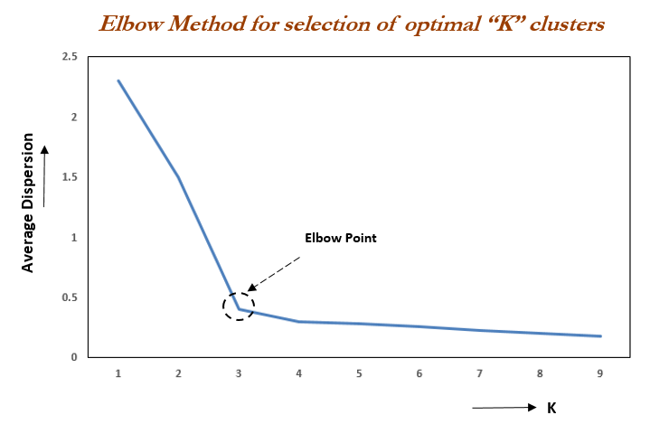
When K increases, the centroids are closer to the clusters centroids.
The improvements will decline, at some point rapidly, creating the elbow shape.
Try to minimize these errors

Slide 38
WSS:Cost Function/Objective
Compute clustering algorithm (e.g., k-means clustering) for different values of k. For instance, by varying k from 1 to 10 clusters.
For each k, calculate the total within-cluster sum of square (wss).
Plot the curve of wss according to the number of clusters k.
The location of a bend (knee) in the plot is generally considered an indicator of the appropriate number of clusters. How they are close to centroid?

Slide 39
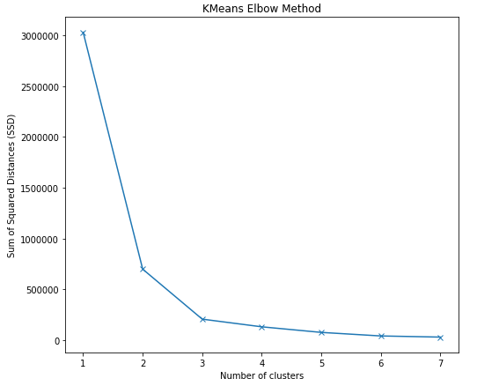
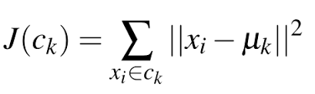
LOSS FUNCTION
Sum of SQUARED DISTANCES
ELBOW

Slide 40
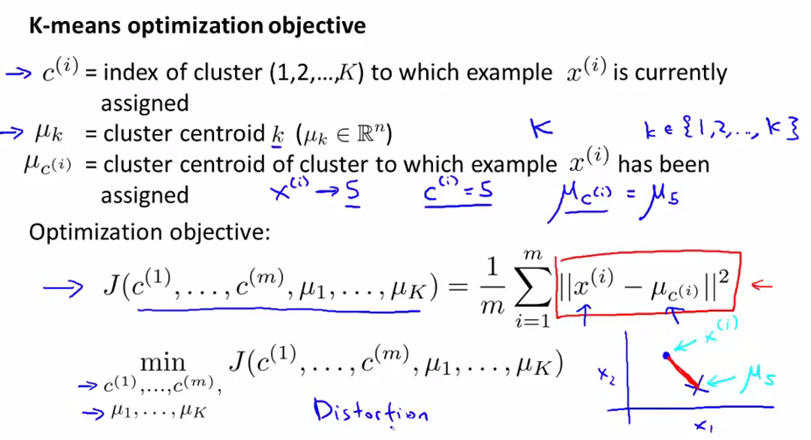
AVERAGE or Minimum

Slide 41
from sklearn.cluster import KMeans from sklearn import metrics from scipy.spatial.distance import cdist import numpy as np import matplotlib.pyplot as plt x1 = np.array([3, 1, 1, 2, 1, 6, 6, 6, 5, 6, 7, 8, 9, 8, 9, 9, 8]) x2 = np.array([5, 4, 5, 6, 5, 8, 6, 7, 6, 7, 1, 2, 1, 2, 3, 2, 3]) plt.plot() plt.xlim([0, 10]) plt.ylim([0, 10]) plt.title('Dataset') plt.scatter(x1, x2) plt.show() # create new plot and data plt.plot() X = np.array(list(zip(x1, x2))).reshape(len(x1), 2) colors = ['b', 'g', 'r'] markers = ['o', 'v', 's']
Elbow -> graph number of clusters

Slide 42
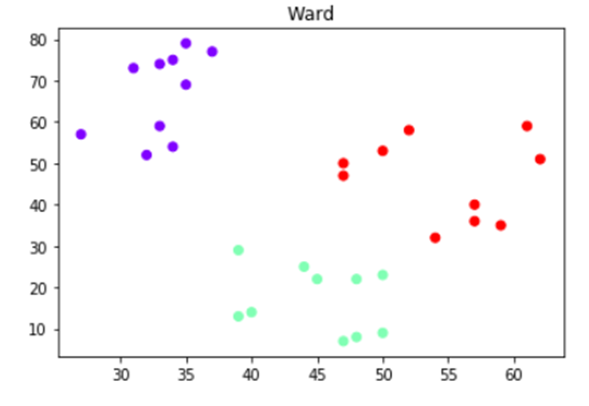
# k means determine k distortions = [] K = range(1,10) for k in K: kmeanModel = KMeans(n_clusters=k).fit(X) kmeanModel.fit(X) distortions.append(np.sum(np.min(cdist(X, kmeanModel.cluster_centers_, 'euclidean'), axis=1)) / X.shape[0]) # Plot the elbow plt.plot(K, distortions, 'bx-') plt.xlabel('k') plt.ylabel('Distortion') plt.title('The Elbow Method showing the optimal k') plt.show()
What is the difference between K-mean Vs Agg Vs A
They are similar
cluster = AgglomerativeClustering(n_clusters=3, affinity='euclidean', linkage='ward')

Slide 43
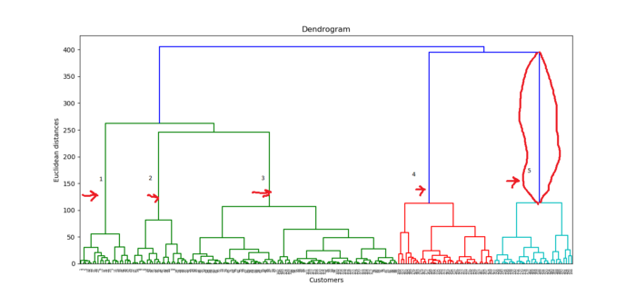
import numpy as np
import matplotlib.pyplot as plt
import pandas as pd
#2 Importing the Mall_Customers dataset by pandas
dataset = pd.read_csv('Mall_Customers.csv')
X = dataset.iloc[:, [3,4]].values
Aggrogradical ->dendrogram
#3 Using the dendrogram to find the optimal numbers of clusters.
# First thing we're going to do is to import scipy library. scipy is an open source
# Python library that contains tools to do hierarchical clustering and building dendrograms.
# Only import the needed tool.
import scipy.cluster.hierarchy as sch
#create a dendrogram variable
# linkage is actually the algorithm itself of hierarchical clustering and then in
#linkage we have to specify on which data we apply and engage. This is X dataset
dendrogram = sch.dendrogram(sch.linkage(X, method = "ward"))
plt.title('Dendrogram')
plt.xlabel('Customers')
plt.ylabel('Euclidean distances')
plt.show()

Slide 44
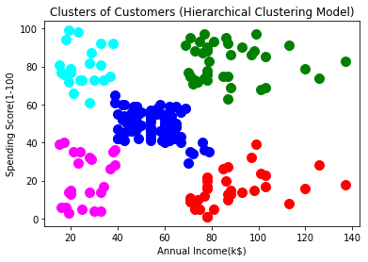
#4 Fitting hierarchical clustering to the Mall_Customes dataset
# There are two algorithms for hierarchical clustering: Agglomerative Hierarchical Clustering and
# Divisive Hierarchical Clustering. We choose Euclidean distance and ward method for our
# algorithm class
from sklearn.cluster import AgglomerativeClustering
hc = AgglomerativeClustering(n_clusters = 5, affinity = 'euclidean', linkage ='ward')
# Lets try to fit the hierarchical clustering algorithm to dataset X while creating the
# clusters vector that tells for each customer which cluster the customer belongs to.
y_hc=hc.fit_predict(X)
#5 Visualizing the clusters. This code is similar to k-means visualization code.
#We only replace the y_kmeans vector name to y_hc for the hierarchical clustering
plt.scatter(X[y_hc==0, 0], X[y_hc==0, 1], s=100, c='red', label ='Cluster 1')
plt.scatter(X[y_hc==1, 0], X[y_hc==1, 1], s=100, c='blue', label ='Cluster 2')
plt.scatter(X[y_hc==2, 0], X[y_hc==2, 1], s=100, c='green', label ='Cluster 3')
plt.scatter(X[y_hc==3, 0], X[y_hc==3, 1], s=100, c='cyan', label ='Cluster 4')
plt.scatter(X[y_hc==4, 0], X[y_hc==4, 1], s=100, c='magenta', label ='Cluster 5')
plt.title('Clusters of Customers (Hierarchical Clustering Model)')
plt.xlabel('Annual Income(k$)')
plt.ylabel('Spending Score(1-100')
plt.show()

Slide 45
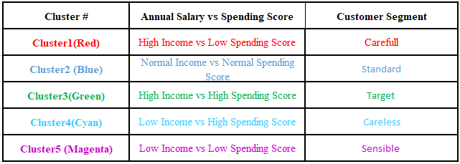

Slide 46
Impact of different distance metrics on hierarchical clustering,

Slide 47
k-means Clustering (BINNING)(MEANMAX) | Hierarchical Clustering (DIFFICULT)
k-means, using a pre-specified number of clusters, the method assigns records to each cluster to find the mutually exclusive cluster of spherical shape based on distance. | Hierarchical methods can be either divisive or agglomerative.
K Means clustering needed advance knowledge of K i.e. no. of clusters one want to divide your data. | In hierarchical clustering one can stop at any number of clusters, one find appropriate by interpreting the dendrogram.
One can use median or mean as a cluster centre to represent each cluster. | Agglomerative methods begin with ‘n’ clusters and sequentially combine similar clusters until only one cluster is obtained.
Methods used are normally less computationally intensive and are suited with very large datasets. | Divisive methods work in the opposite direction, beginning with one cluster that includes all the records and Hierarchical methods are especially useful when the target is to arrange the clusters into a natural hierarchy.
In K Means clustering, since one starts with random choice of clusters(WEAKEST), the results produced by running the algorithm many times may differ. | In Hierarchical Clustering, results are reproducible in Hierarchical clustering
K- means clustering a simply a division of the set of data objects into non-overlapping subsets (clusters) such that each data object is in exactly one subset). | A hierarchical clustering is a set of nested clusters that are arranged as a tree.
K Means clustering is found to work well when the structure of the clusters is hyper spherical (like circle in 2D, sphere in 3D). | Hierarchical clustering don’t work as well as, k means when the shape of the clusters is hyper spherical.
Advantages: 1. Convergence(very good clusters) is guaranteed. 2. Specialized to clusters of different sizes and shapes. | Advantages: 1 .Ease of handling of any forms of similarity or distance. 2. Consequently, applicability to any attributes types.
Disadvantages: 1. K-Value is difficult to predict 2. Didn’t work well with global cluster. | Disadvantage: 1. Hierarchical clustering requires the computation and storage of an n×n distance matrix. For very large datasets, this can be expensive and slow

Slide 48
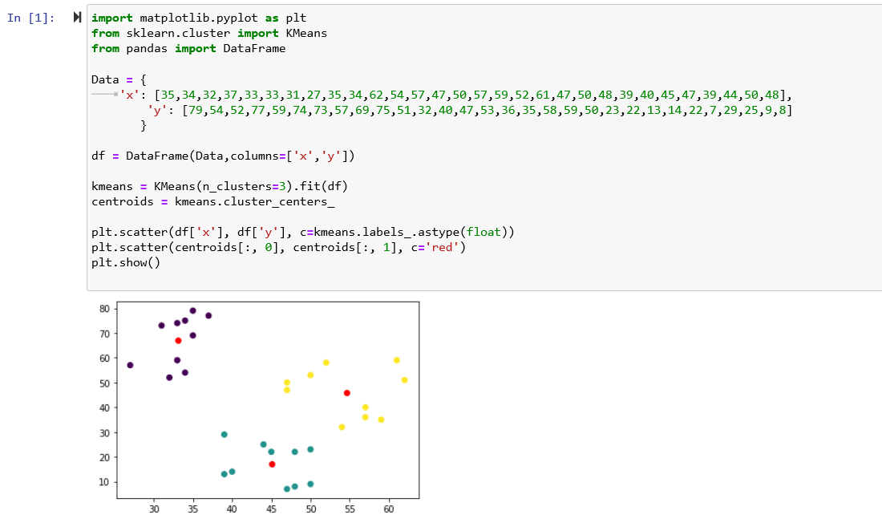

Slide 49
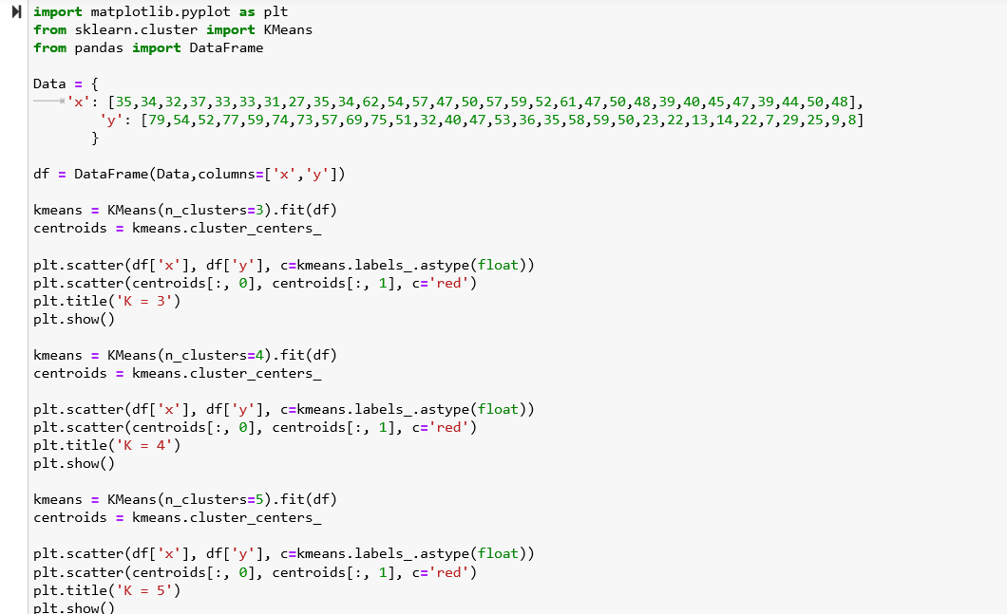

Slide 50
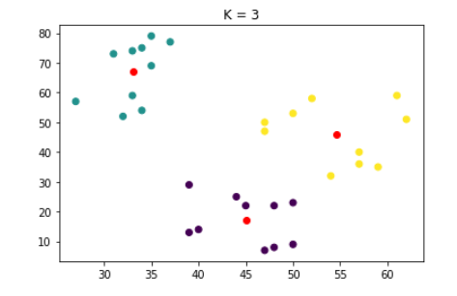
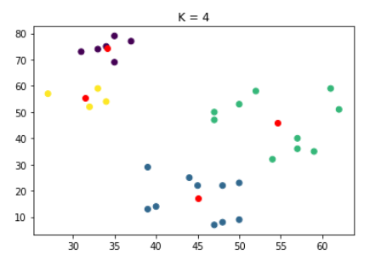
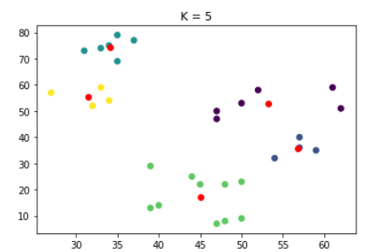
K-3 good balance
Take Dataset Mall
I have which K works better
Elbow method
Apply Agglomerative
Apply Dendrogram
What is the Trush Hole to get k=5
5 clusters. Follow the slides
DEADLINE IS Mid MONDAY

Slide 51
